Slide 1
Lecture 13: Life Skill: Documentation
CSC111: Introduction to CS through Programming
R. Jordan Crouser
Assistant Professor of Computer Science
Smith College

Slide 2
Overview
Announcements
Debrief of “Life Skill #2: Debugging”
Loops
for…in (looping through items in a list)
the range() function (getting a list of numbers)
while (looping until something happens)
The random module
Lab: Old MacDonald
Life Skill #3: Documentation

Slide 3
In the beginning…

Slide 4
Now…

Slide 5
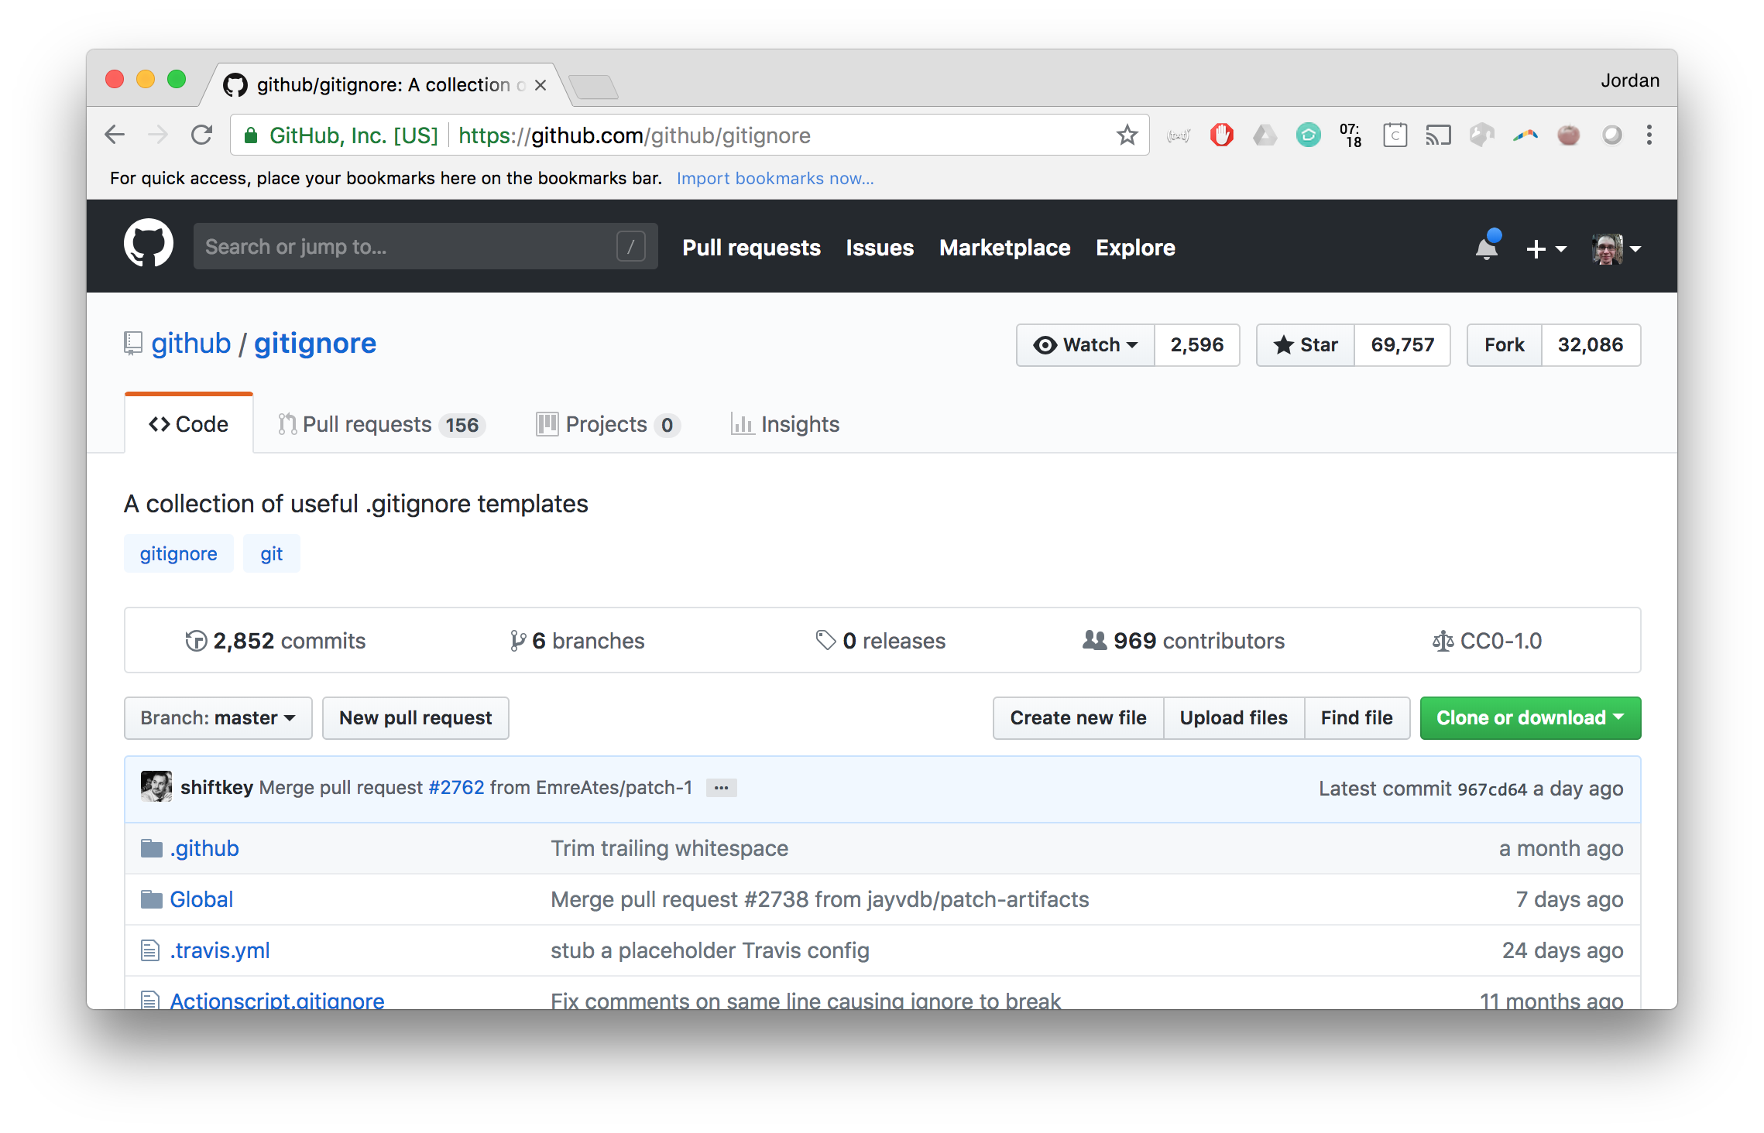
Eventually…

Slide 6
The point
Other people need to be able to understand your code
Future you needs to be able to understand your code
Document it
… but how?

Slide 7
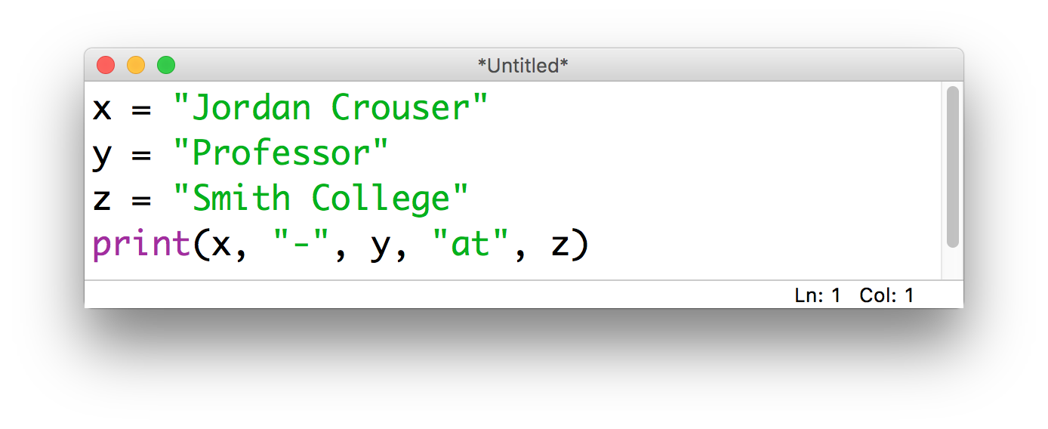
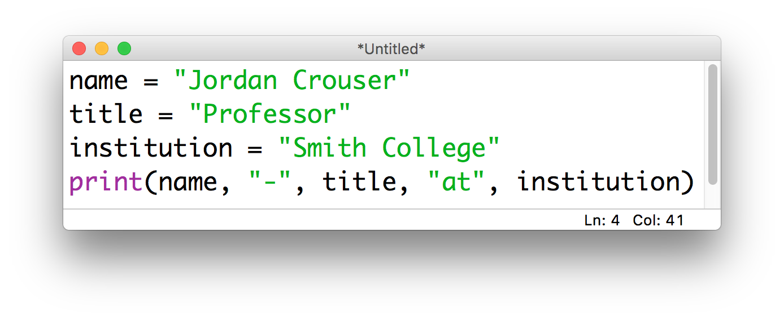
Step 1: meaningful nouns for variables

Slide 8
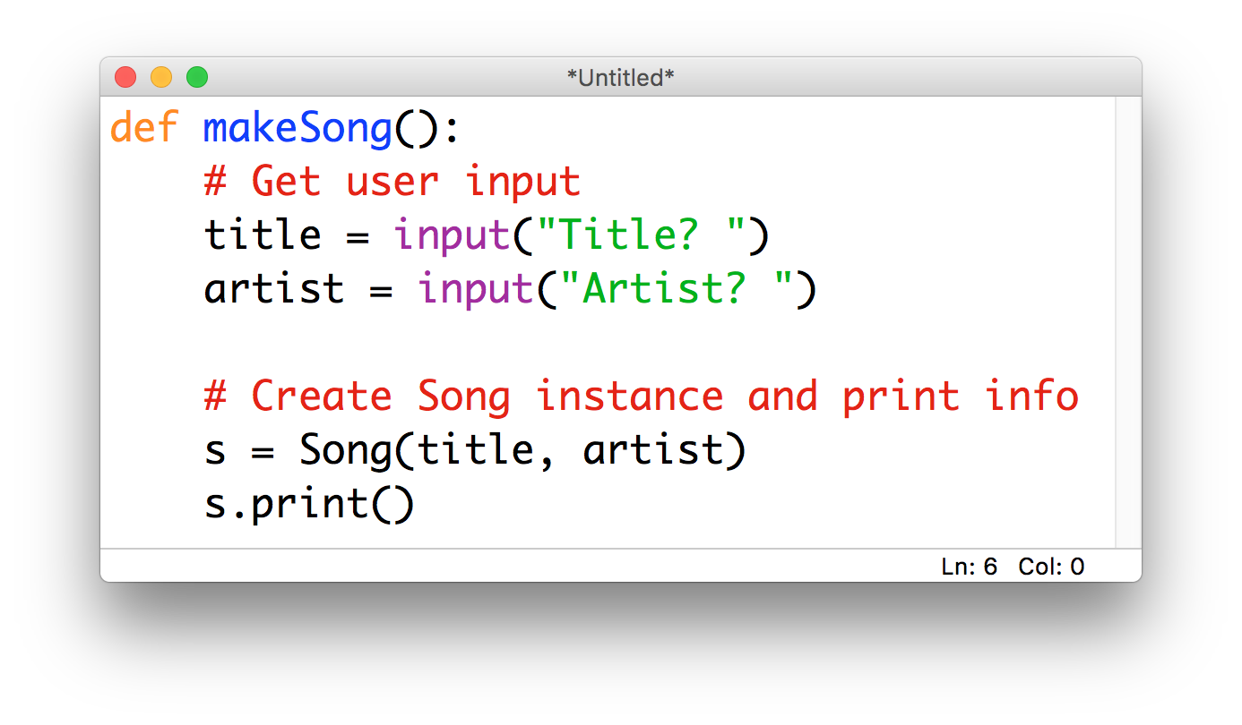
Step 2: lots of comments

Slide 9
A useful technique: code tracing
Given: a very short, poorly-documented program
Your goal: try to figure out what it’s doing
Recommendations:
walk through the program step-by-step (“trace its execution”) using the whiteboard or paper instead of typing it into IDLE
once you understand what’s happening, then rewrite it using informative variable names and comments

Slide 10
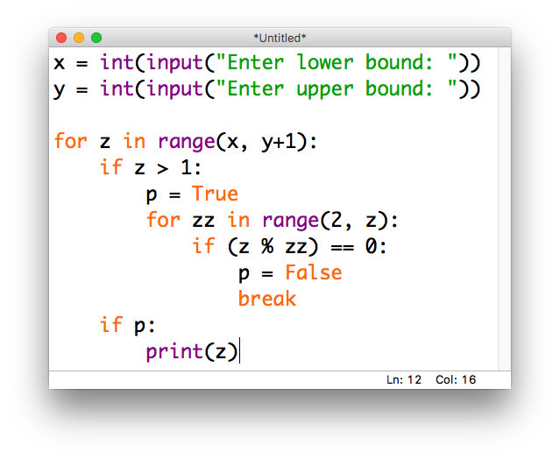
Example

Slide 11

Debrief
This is great, but what about when
our programs get more complicated?

Slide 12
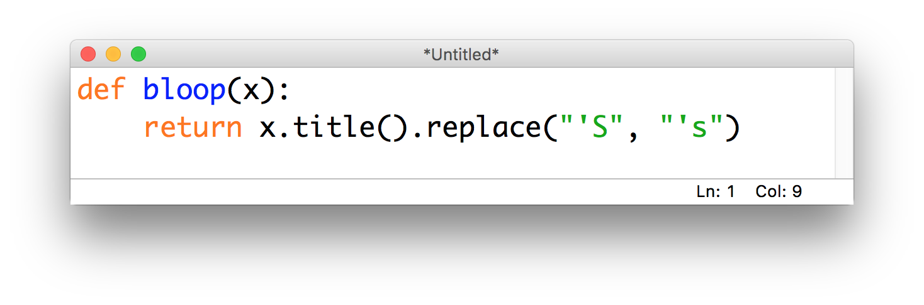
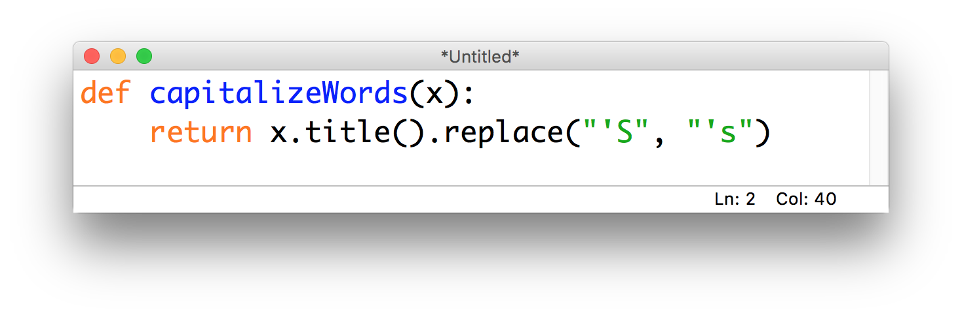
Step 3*: describe the action for functions

Slide 13
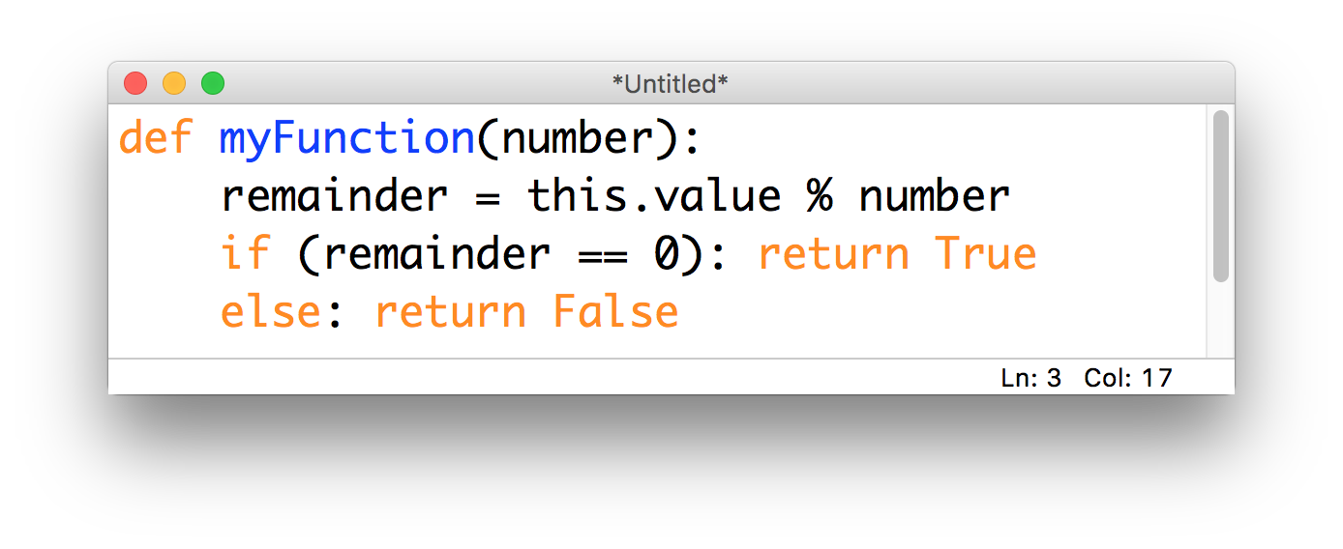
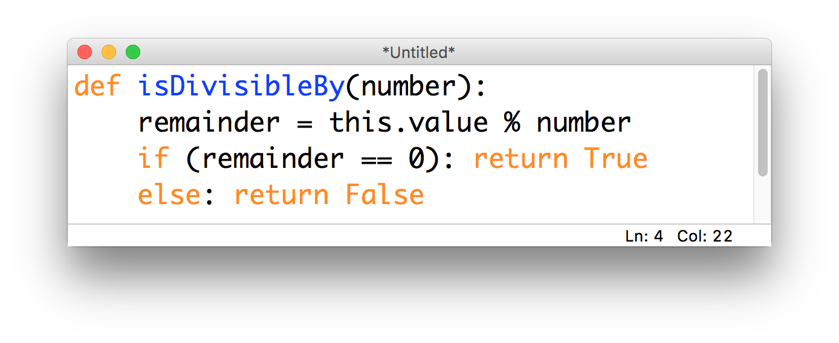
Step 3*: describe the action for functions

Slide 14
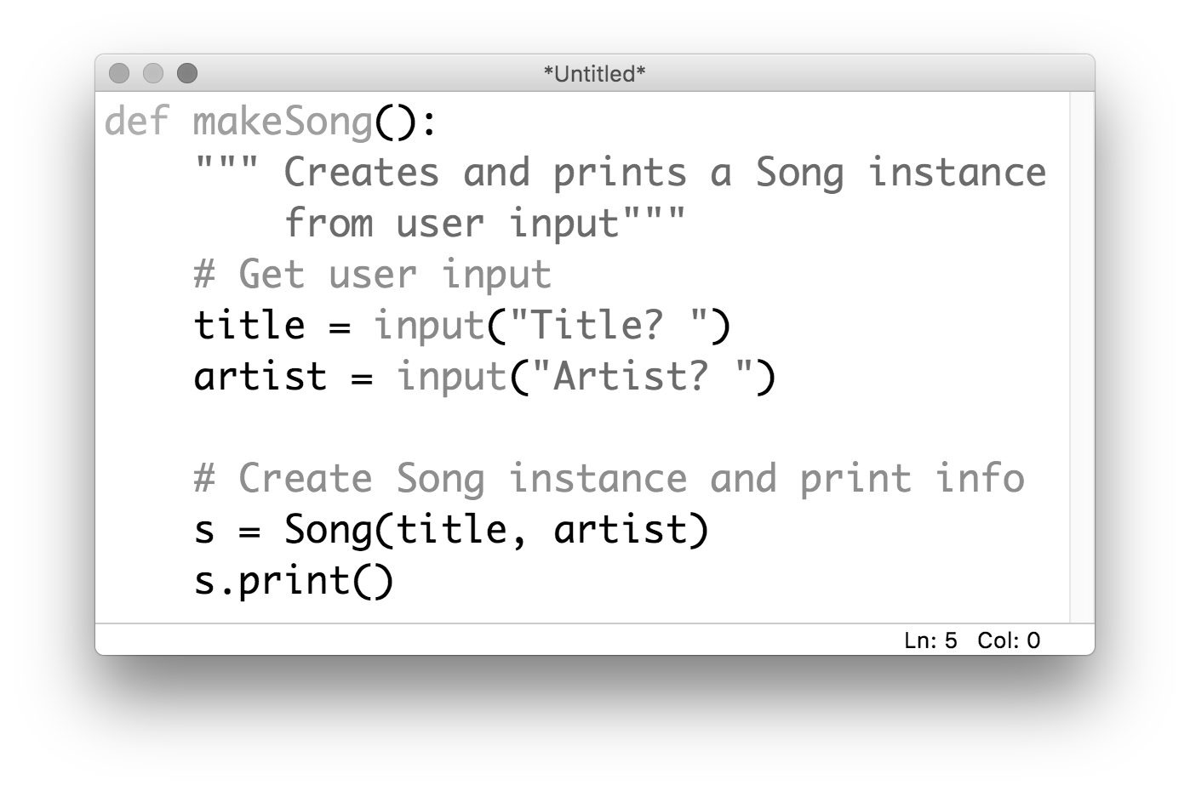
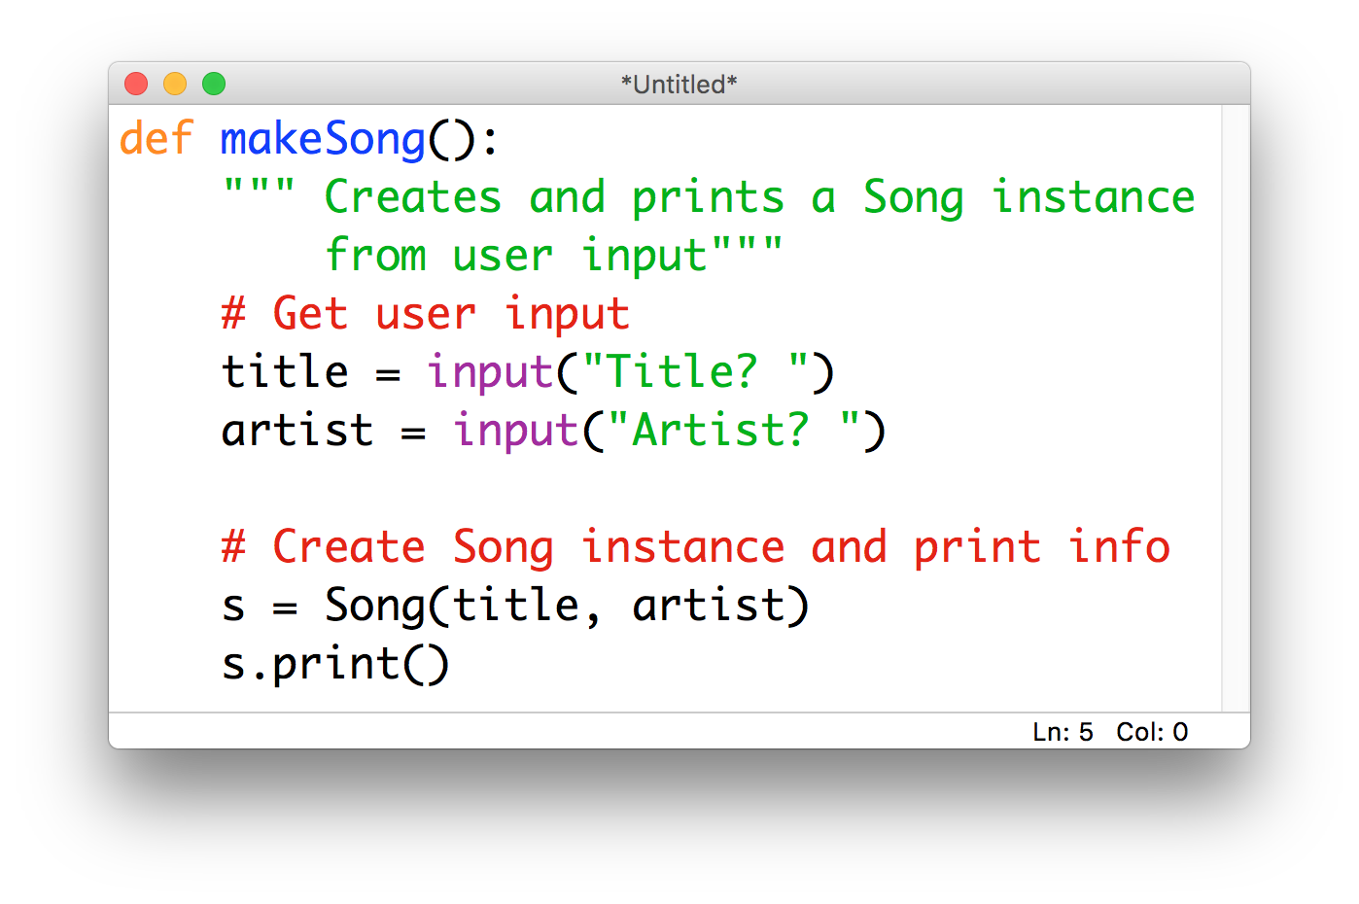
Step 4*: docstrings
Notes:
Python documentation strings (docstring) are a convenient way of associating documentation with modules, functions, classes, and methods.
An docstring is defined by including a multiline string as the first statement in the object‘s definition.
It's specified in source code and is used, like a comment, to document a specific segment of code.
The docstring should describe what the function does, not how. In big-kid programming, EVERY FUNCTION should have one.
It might look like just another comment, but it has some really cool functionality

Slide 16
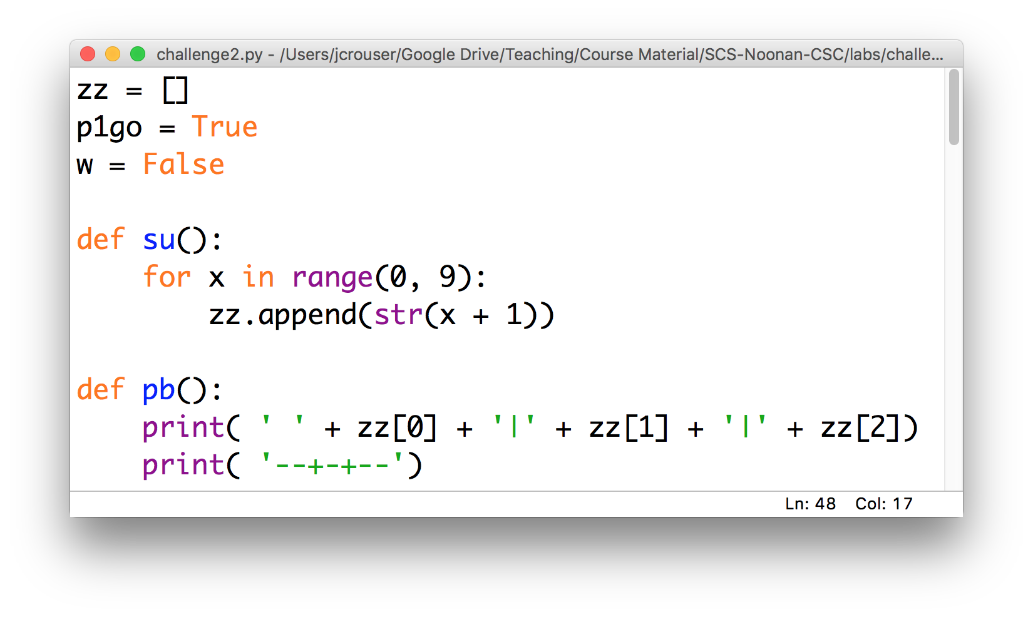
Activity: “code detective”
challenge2.py

Slide 17
Debrief
What was that experience like?
What strategies did you use?

Slide 18
Coming up next
A4: Magic 8 Ball is due Sunday 11:55pm
Mon 10/8: NO CLASS (FALL BREAK)
Weds 10/10: Writing functions
Lab: MadLibs
Fri 10/5: Working with Files

